Slide 1
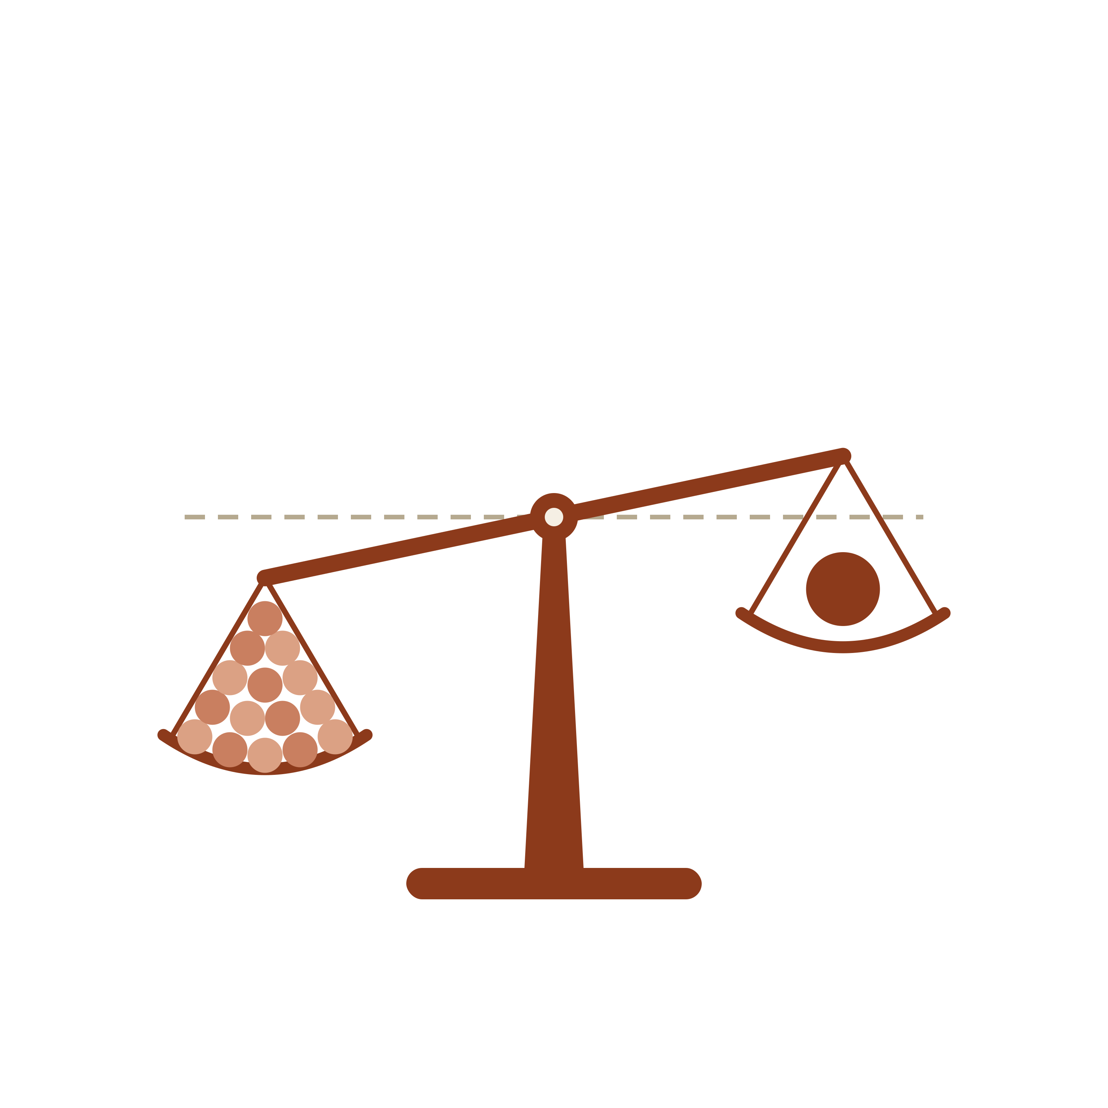
EPC 2026
Strategy Frequency Biases Metacognitive Beliefs About Efficacy
Kit Double
Hilary Don
David Shanks
Evan Livesey
KIT.DOUBLE@SYDNEY.EDU.AU

Slide 2
CENTRAL QUESTION
Why do learners hold strong efficacy beliefs in cognitive strategies that are demonstrably ineffective, and why do those beliefs persist?
02

Slide 3
INTRODUCTION / NELSON & NARENS (1990)
Metacognition is monitoring and control
The meta level holds a model of the object level — monitoring it from below and controlling it from above.
Metacognitive beliefs form via this system. Are they causal beliefs?
"Does deploying this action tend to produce successful outcomes?"
N&N FRAMEWORK
03

Slide 4
REFRAMING METACOGNITION
Metacognitive beliefs are (often) causal beliefs
CANDIDATE CAUSE
OUTCOME
CAUSAL BELIEF
Strategy use
Successful learning
"This strategy works"
e.g. re-reading a passage before a test
a correct answer, a felt sense of mastery
a durable impression of causal strength
Why?
Causal-learning research already explains how such beliefs form across repeated pairings and how they are systematically biased. We can import those predictions directly.
METACOGNITIVE BELIEFS
04

Slide 5
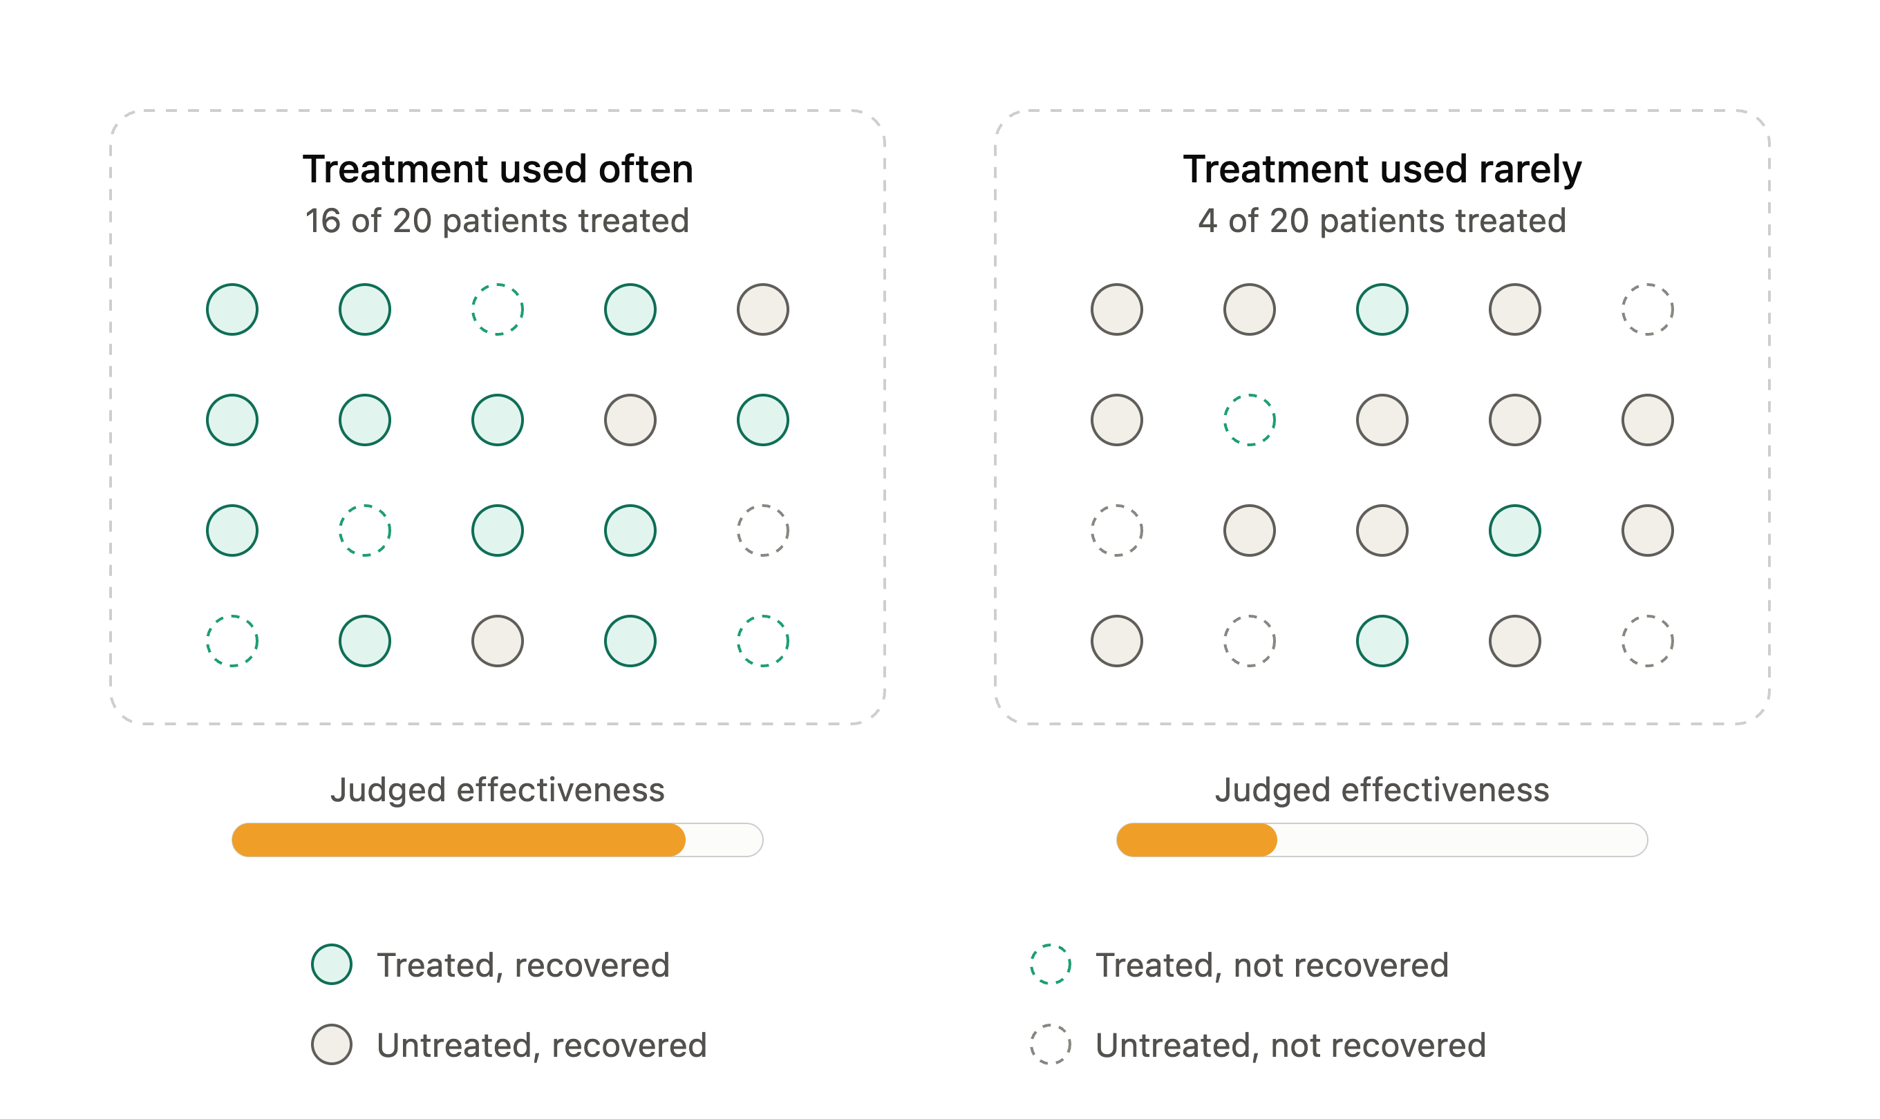
A ROBUST FINDING IN CONTINGENCY LEARNING
Frequency effects in Causal Learning
Causal strength is over-estimated for frequently occurring candidate causes — independent of their true contingency with the outcome.
A frequent cause produces more cue–outcome co-occurrences, inflating the apparent evidence base — even when the cause is completely inert.
APPLIED TO STUDY
A strategy used often coincides with more successes simply because it generates more pairings — regardless of whether it caused them.
FREQUENCY EFFECTS
05

Slide 6
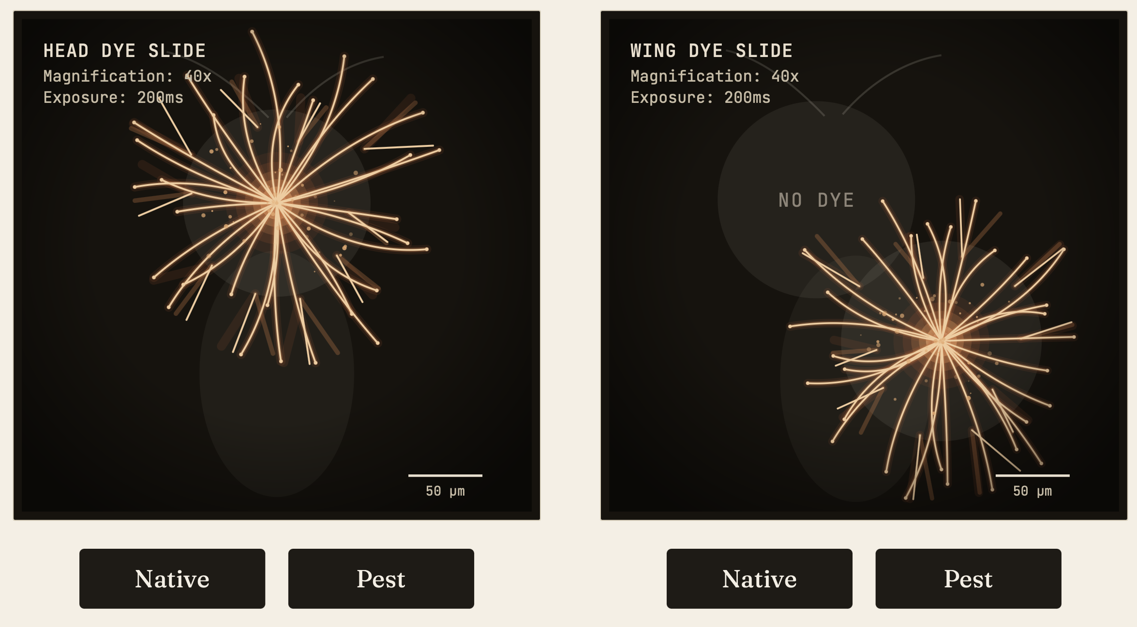
METHOD / THE BEETLE PARADIGM
A task where strategy efficacy is fully controlled
COVER STORY
An agricultural crisis: classify beetles as Native vs Pest from fluorescent neural patterns under the microscope.
PREDETERMINED FEEDBACK
Correct / incorrect is assigned in advance. Accuracy rates (75 / 50 / 25%) are controlled independently of responses.
METHOD · BEETLE PARADIGM
07

Slide 7
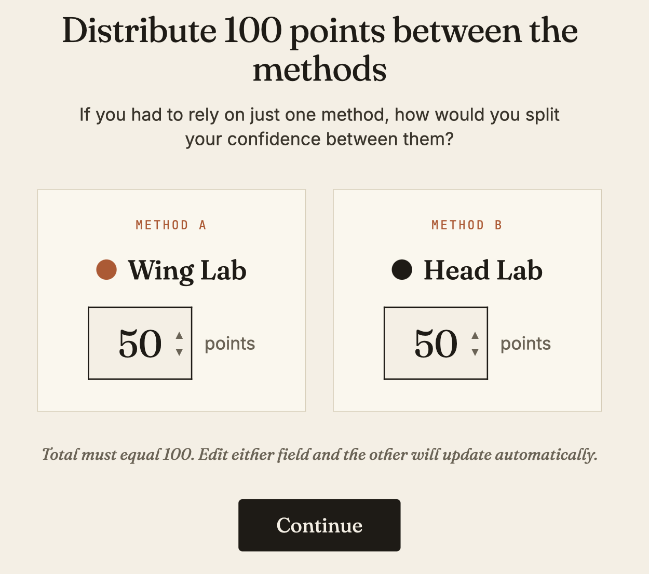
METHOD / THE BEETLE PARADIGM
A task where strategy efficacy is fully controlled
IMPOSSIBLE CATEGORY STRUCTURE
No feature is diagnostic — values are fixed across categories with 5% jitter. No strategy can truly work.
ORTHOGONAL MANIPULATION
Strategy frequency (head / wing inspection) and feedback accuracy varied independently — frequency via a 75:25 split across 100 trials.
Efficacy Beliefs
Because real efficacy is held at zero, any belief that one strategy "works better" is, by construction, a bias.
METHOD · BEETLE PARADIGM
07

Slide 8
COMPETING ACCOUNTS / WHAT IS THE FREQUENCY CUE DOING?
Two testable predictions
CONTINGENCY-BASED
FAMILIARITY-BASED
Frequency inflates the count of strategy–success co-occurrences
Repeated use makes a strategy feel trustworthy, regardless of outcomes
Prediction: the effect should depend on outcome valence — strongest at 75% accuracy, absent below chance.
Prediction: the effect should persist across every accuracy condition.
EXPERIMENT 1
Manipulating feedback accuracy (75 / 50 / 25%) pits these predictions against each other directly.
PREDICTIONS
06

Slide 9
EXPERIMENT 1 / DOES FREQUENCY BIAS EFFICACY BELIEFS? N = 720
Fully between-subjects, 3 × 3 design
75% ACC.
50% ACC.
25% ACC.
Head frequent
n = 80
n = 80
n = 80
Even (50/50)
n = 80
n = 80
n = 80
Wing frequent
n = 80
n = 80
n = 80
Prolific adults. Within every cell, accuracy is equated across the head and wing strategies — only their frequency differs.
FAMILIARITY-BASED
The frequent strategy was rated more efficacious — and the effect did not depend on accuracy . A robust, valence-invariant frequency bias.
EXPERIMENT 1 · N = 720
08

Slide 10
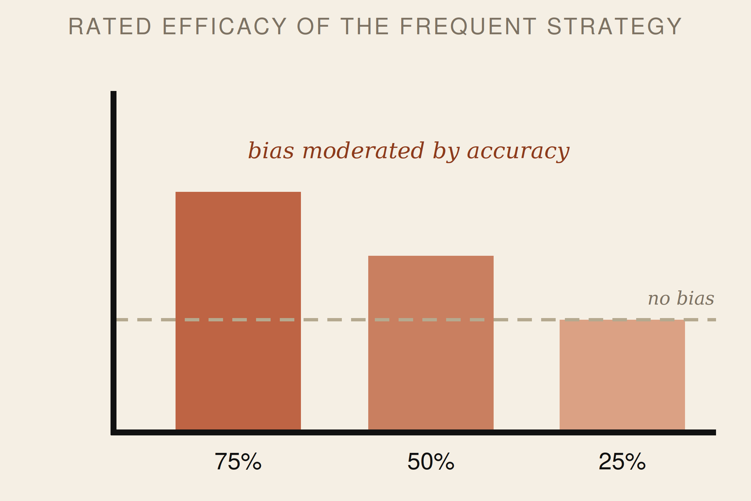
EXPERIMENT 1 / DOES FREQUENCY BIAS EFFICACY BELIEFS? N = 720
Fully between-subjects, 3 × 3 design
75% ACC.
50% ACC.
25% ACC.
Head frequent
n = 80
n = 80
n = 80
Even (50/50)
n = 80
n = 80
n = 80
Wing frequent
n = 80
n = 80
n = 80
Prolific adults. Within every cell, accuracy is equated across the head and wing strategies — only their frequency differs.
CONTINGENCY-BASED
The frequent strategy was rated more efficacious — but the effect did depend on accuracy . With bias present when accuracy is high, but not low.
EXPERIMENT 1 · N = 720
08

Slide 11
EXPERIMENT 1 / DOES FREQUENCY BIAS EFFICACY BELIEFS? N = 720
Fully between-subjects, 3 × 3 design
75% ACC.
50% ACC.
25% ACC.
Head frequent
n = 80
n = 80
n = 80
Even (50/50)
n = 80
n = 80
n = 80
Wing frequent
n = 80
n = 80
n = 80
Prolific adults. Within every cell, accuracy is equated across the head and wing strategies — only their frequency differs.
EXPERIMENT 1 · N = 720
08

Slide 12
EXPERIMENT 1 / DOES FREQUENCY BIAS EFFICACY BELIEFS?
A frequency bias at 75% and 50% accuracy, but not 25%
CONTINGENCY-BASED
The frequent strategy was rated more efficacious — but the effect did depend on accuracy . With bias present when accuracy is high, but not low.
EXPERIMENT 1
08

Slide 13
EXPERIMENT 2 / FREQUENCY VS GENUINE EFFICACY N = 240
Does frequency still bias when one strategy really is better?
One strategy delivers 75% accuracy, the other 50% — with frequency manipulated independently.
FINDING 1 — REAL EFFICACY IS TRACKED
Sensitive to true performance
In the Even -frequency condition, participants allocated more points to the objectively better (75% accurate) strategy.
EXPERIMENT 2 · N = 240
09

Slide 14
EXPERIMENT 2 / FREQUENCY VS GENUINE EFFICACY N = 240
Does frequency still bias when one strategy really is better?
One strategy delivers 75% accuracy, the other 50% — with frequency manipulated independently.
FINDING 2 — BUT FREQUENCY BIAS PERSISTS
Frequency still biases
Participants still rate the more frequently encountered strategy as more effective than the less frequent strategy
EXPERIMENT 2 · N = 240
09

Slide 15
EXPERIMENT 2 / FREQUENCY VS GENUINE EFFICACY N = 240
Does frequency still bias when one strategy really is better?
One strategy delivers 75% accuracy, the other 50% — with frequency manipulated independently.
FINDING 1 — REAL SIGNAL IS TRACKED
FINDING 2 — BUT FREQUENCY BIAS PERSISTS
Sensitive to true performance
Frequency still biases
In the Even -frequency condition, participants allocated more points to the objectively better (75%) strategy.
Participants still rate the more frequently encountered strategy as more effective than the less frequent strategy
KEY POINT
The two influences are additive — a non-significant interaction. Frequency biases beliefs even when there is real efficacy to track.
EXPERIMENT 2 · N = 240
09

Slide 16
EXPERIMENT 3 / DO BIASED BELIEFS CHANGE BEHAVIOUR? N = 240
From belief to choice
RESULT
Participants chose the previously frequent strategy significantly more often. These are not simply measurement artefacts — frequency affects subsequent action.
EXPERIMENT 3 · N = 240
10

Slide 17
CONTRIBUTION / WHAT KIND OF CUE IS FREQUENCY?
A distributional account of strategy belief
EXISTING CUE-UTILISATION ACCOUNTS
FREQUENCY AS A DISTRIBUTIONAL CUE
Local, item-level cues
A global, higher-order cue
Fluency, ease of retrieval, familiarity — tied to an individual judgment in the moment.
Derived from the cumulative structure of experience across many episodes: how often does success co-occur with this strategy?
EXTENSION TO N&N
Specifies one way the meta level acquires its beliefs — not just from local fluency, but from the distribution of success over a strategy's history.
CONTRIBUTION · DISTRIBUTIONAL CUE
11

Slide 18
A FEEDBACK LOOP?
A self-sustaining cycle
WHY BELIEFS PERSIST
12

Slide 19

CONCLUSIONS
What to take away
Strategy frequency is an underappreciated source of bias in metacognitive belief formation.
Metacognitive beliefs about what works are shaped not only by objective outcomes, but by how evidence is distributed across experience.
Biased beliefs translate into biased choice — creating the conditions for self-perpetuating cycles.
Causal-learning frameworks as a bridge to how stable strategy beliefs form and resist correction.
THANKS
Hilary Don, Evan Livesey, & David Shanks
STRATEGY FREQUENCY BIASES · EPC 2026
13

